Slide 1
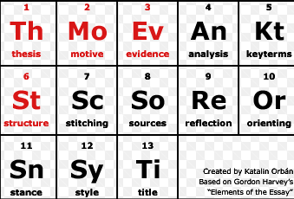
The Argument Unit
ELEMENTS OF ARGUMENT

Slide 2
WHAT IS YOUR DEFINITION OF AN ARGUMENT?
In your notebook write your answer.
Share and try to improve your answer.

Slide 3
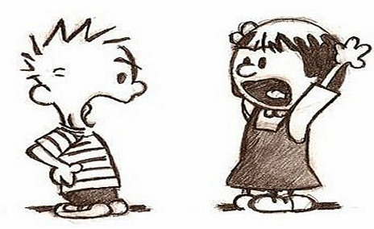
What Is an Argument?
An argument is an opinion supported by facts.

Slide 4
1. WHAT IS YOUR DEFINITION OF FACT? 2. WHAT IS YOUR DEFINITION OF OPINION?
In your notebook write your answers.
Share and try to improve your answers.

Slide 5
Fact vs. Opinion
Facts can be proven or supported.
Opinions are personal feelings.
Argument writers use both fact and opinion.

Slide 6
OPINIONS as CLAIMS FACTS as EVIDENCE
Writers refer to opinions as claims and facts as evidence.
The claim clearly states a stance on a topic or issue.
Evidence to prove a claim include reasons, statistics, confirmed facts, and expert research.
CLAIM
EVIDENCE
ARGUMENT

Slide 7
The 5 types of EVIDENCE
1. Confirmed Facts - facts that have been found in
reliable/credible sources.
2. Statistics - numbers and percentages that are relevant
to the topic and come from reliable/credible sources.
3. Expert Research - research that is done by professors,
researchers, or doctors who have a deep knowledge of
the topic; always found in credible/reliable sources.
4. Personal Experience - any actual experience with
the topic that you, your family and friends have had.
5. Reasons - logical reasons that support the opinions
made in the claim.

Slide 8
Name the EVIDENCE Game
The DEBATABLE CLAIM you will be naming the evidence of is:
Year-round school improves students’ academic achievement.

Slide 9
Personal Experience, Reason, Confirmed Fact, Statistic or Research by Expert
What kind of evidence is this?
A review of 39 studies confirmed summertime learning loss: test scores drop over summer vacation (Cooper, 2006)
Research by Expert

Slide 10
Personal Experience, Reason, Confirmed Fact, Statistic or Research by Expert
What kind of evidence is this?
According to StatisticBrain.com, year-round schools have lower drop-out rates (2%) than traditional schools (5%)
Statistic

Slide 11
Personal Experience, Reason, Confirmed Fact, Statistic or Research by Expert
What kind of evidence is this?
A study done by Education Week followed six elementary schools, three on traditional calendars and three on year-round schedules, and found positive effects of year-round education. The sample of students in the year-round schools posted overall test-scores that were higher than students at the schools with traditional calendars.
Confirmed Fact

Slide 12
Personal Experience, Reason, Confirmed Fact, Statistic or Research by Expert
What kind of evidence is this?
I forgot fewer of my math skills over the summer because my summer break was so short thanks to year-round school.
Personal Experience

Slide 13
Personal Experience, Reason, Confirmed Fact, Statistic or Research by Expert
What kind of evidence is this?
Because students have multiple breaks throughout the year, they experience less academic burnout. They have frequent opportunities to refresh and restart their learning experience.
Reason

Slide 14
How do you respond in an argument?
You respond with a rebuttal or counter argument when you disagree with someone.

Slide 15
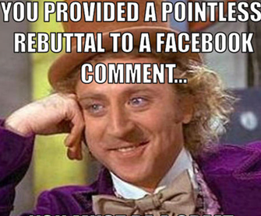
Rebuttal
the word can apply to any situation in which an argument is put forth and someone disagrees, and explains why.

Slide 16
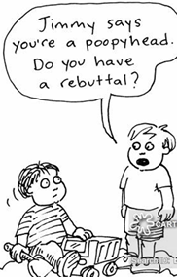
Rebuttal (continued)
When two people debate, one of them makes an argument, and the other follows with a rebuttal, which, plainly put, is the "no, you're wrong and this is why" argument.

Slide 17
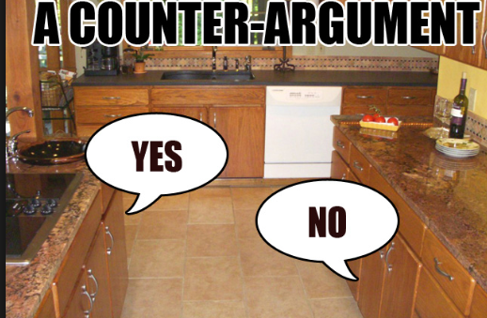
Counter Argument:
a contrasting, opposing, or refuting argument.
A counter-argument is an argument opposed to your claim. It expresses the view of a person who disagrees with your stance or position on a debatable topic.

Slide 18
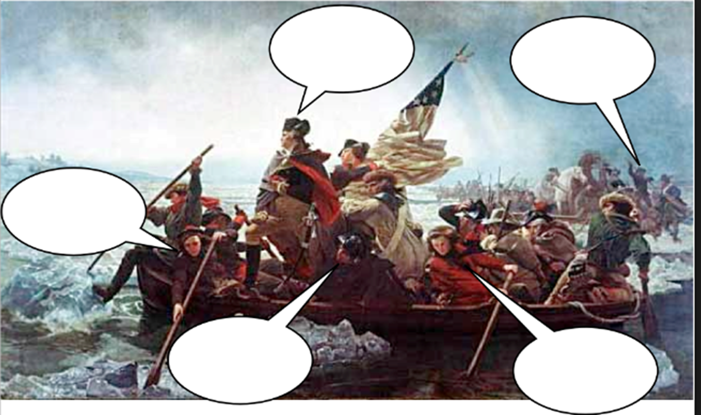
Write Washington’s Claim
Now write rebuttals to that claim

Slide 19
Write Washington’s Claim
Now write rebuttals to that claim
The Chargers
are the best!
No, they
didn‘t make the
playoffs.
Not the best if they leave San
Diego.
Maybe if they still had Drew Brees.
No way, they
have never won
a Super Bowl

Slide 20
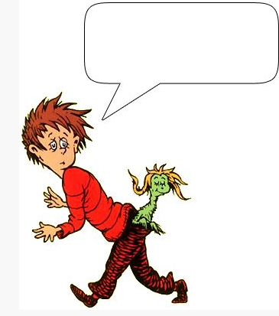
Write a claim and a rebuttal

Slide 21
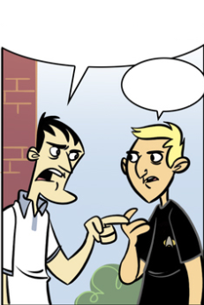
Write a claim and a rebuttal

Slide 22
Write 2 claims and 2 rebuttals

