Slide 1
AGENDA FOR NEXT FEW WEEKS:
List of significant people from history
You will pick 3-5 you would like to research
Make an infomercial/presentation about the person
Participate in a Socratic Seminar supporting the person
Write an essay about why your person is the most significant
Study about ethos, pathos, logos (will be starting this today)

Slide 2
Ethos, Pathos, and Logos
modes of persuasion

Slide 3
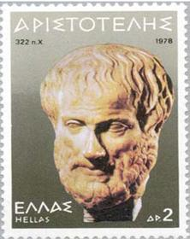
modes of persuasion
According to Greek philosopher and scientist Aristotle (384-322 BCE), a speaker or writer has
3 ways to persuade an audience.

Slide 4
What is rhetoric?
It is a noun with many definitions:
1. the ability to use language effectively.
2. the art of making persuasive speeches.
3. the art of influencing the thought and conduct of an audience.

Slide 5
Aristotle in The Art of Rhetoric:
“Of the modes of persuasion furnished by the spoken word there are three kinds. The first kind depends on the personal character of the speaker; the second on putting the audience into a certain frame of mind; the third on the proof, provided by the words of the speech itself.”

Slide 6
Ethos: Appealing to the speaker or writer’s character or reputation.
Ethos (Greek for character) refers to credibility:
Convincing by the character of the author*
We tend to believe people whom we respect.
Is the writer/speaker:
someone worth listening to?
an authority?
likeable and worthy of respect?
*Henceforth the terms writer or author will represent those of speaker, speechwriter as well.
TESTIMONIAL & TRANSFER

Slide 7
Logos: Appealing to the reader’s or listener’s sense of reason.
CARDSTACKING
Logos (Greek for 'word')
This was Aristotle's favorite technique.
It relies on making a logical argument, backed with reason or evidence to persuade the audience.

Slide 8
Pathos: Appealing to the reader’s or listener’s emotions.
GLITTERING
NAME CALLING
BANDWAGON
Pathos (Greek for suffering) refers to emotions:
Pathos is often associated with emotional appeal, but a better equivalent might be appeal to the audience's sympathies and imagination. An appeal to pathos causes an audience not just to respond emotionally but to identify with the writer's point of view--to feel what the writer feels. Writers often use narrative, or story, to turn the ideas of logic into something real for the reader. The values, beliefs, and understandings of the writer are implicit in the story and conveyed imaginatively (the reader imagines himself/herself in the author’s place) to the reader. Pathos thus refers to both the emotional and the imaginative impact of the message on an audience, moving the audience to decision or action.

Slide 9
Ethos, Pathos, and Logos
You Tube Video:
The Art of Rhetoric: Persuasive Techniques in Advertising
https://www.youtube.com/watch?v=FeCz5fy02JE

Slide 10
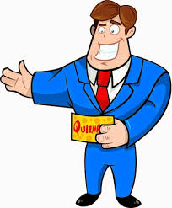
Ethos, Pathos, and Logos
You make the call!

Slide 11
The Ethos, Pathos, and Logos Game
How to play!
Analyze the image
Answer for the image(s), not the super-fine print
Write down your answer (the ad MAY use more than one mode of persuasion)

Slide 12
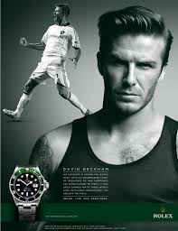
You Make the Call!
1.
ethos

Slide 13
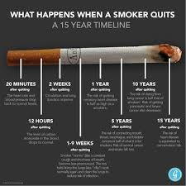
You Make the Call!
logos
2.

Slide 14
You Make the Call!
logos
3.

Slide 15
You Make the Call!
ethos
4.

Slide 16
You Make the Call!
pathos
5.

Slide 17
You Make the Call!
logos
6.

Slide 18
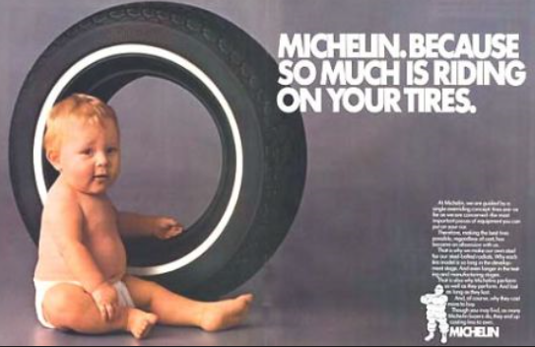
You Make the Call!
pathos
7.

Slide 19
You Make the Call!
ethos/logos
8.

Slide 20
You Make the Call!
ethos
9.

Slide 21
You Make the Call!
10.
PATHOS

Slide 22
Harry, Ron, Hermione
Which character is ethos, logos, and pathos?
Hmmm... Was J.K. Rowling thinking of the modes of persuasion when she created the main characters in Harry Potter?

