Slide 1
Gather research about your significant person (for essay, Socratic Seminar, etc.)
Save the URL (web address) of ANY evidence you find interesting and potentially usable
Try to group the evidence into ETHOS, PATHOS, or LOGOS
Prepare a 3 truths and 1 lie presentation to introduce your person to the class
The presentation needs to have:
A clear opening (introduce both yourself and who you are presenting)
Present 4 facts about your significant person (in which one is fallacious or untrue)
Support/prove the 3 truths with evidence to back up your statements
A proper MLA bibliography
A clear closing/the end (perhaps thank the audience for listening)
VOTE FOR STANDLEY STANDOUTS GOOGLE CODE 0533hmh

Slide 2
Find evidence to support the claim that your person is the most significant.
Gather as much information as you can
(3 facts for the presentation, 9 for the essay, unlimited for the Socratic Seminar)address)
Task 1 will be a 3 truths and a lie presentation
Task 2 will be a Socratic Seminar
Task 3 an argumentative essay
When researching use credible sites
House it all in one place (keep the web addresses or URLs)ink/URL/web
Try to find these types of evidence: STATISTICS, CONFIRMED FACTS, and EXPERT RESEARCH

Slide 3
Why is your person most significant?
LEGACY
ACCOMPLISHMENTS
RECOGNITION
CHARITY WORK
HUMANITARIANISM
CONTRIBUTIONS
ADVOCACY
TRAGEDIES
FINANCIAL
INVENTIONS
TALENTS

Slide 4
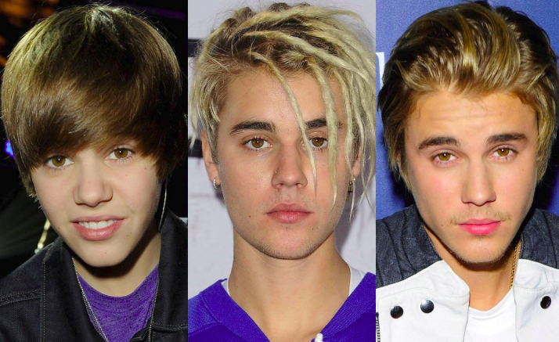
3 truths & a lie
Justin Bieber presented by MR. MARKOWITZ

Slide 5
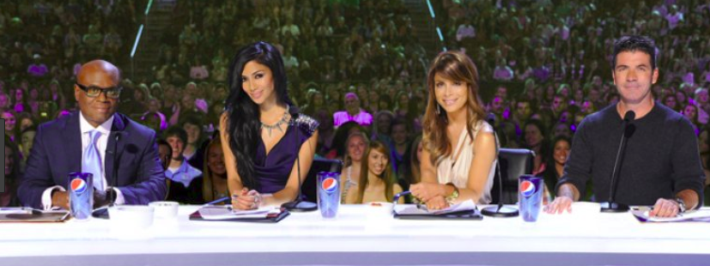
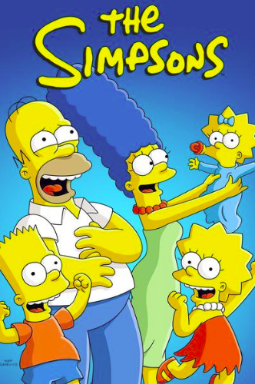
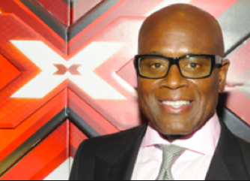
1. L.A. Reid produced his first album and has been on The Simpson’s multiple times.

Slide 6
2. He was born in London.

Slide 7
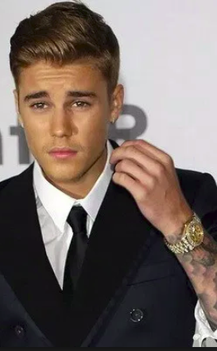
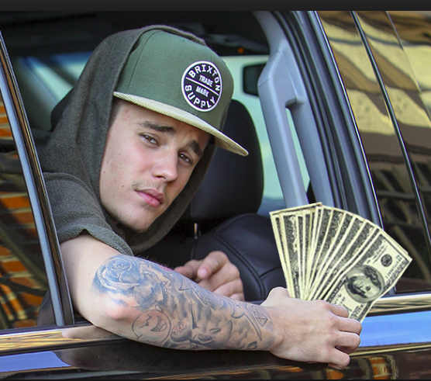
3. His net worth is 265 million dollars.

Slide 8
4. He is in the top 5 most followed on Twitter and Instagram

Slide 9
Choose which one was the lie.

Slide 10
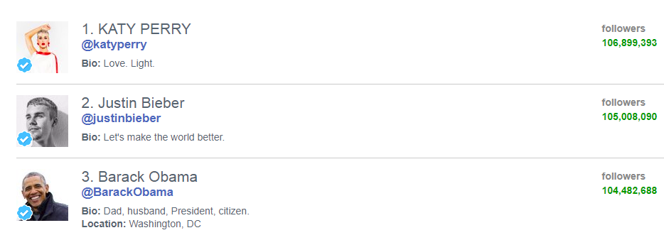
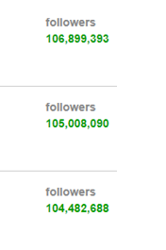
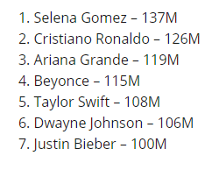
4. He is NOT on the top 5 list of the most followed on Twitter and Instagram

Slide 11
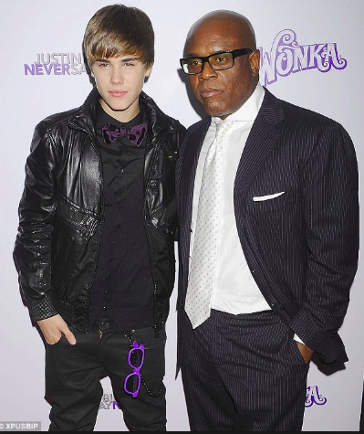
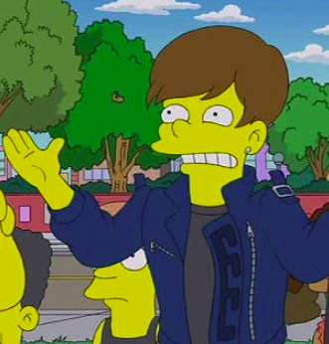
According to Celebrity Net Worth, Justin Bieber’s net worth is $265 million as of March 2018, thanks to his music sales, merchandise, product endorsements, touring and other business ventures.
The executive producer of his first record, "My World", was L.A. L.A. Reid.

Slide 12
MLA CITATION OF WORKS CITED
"Justin Bieber." IMDb. IMDb.com. 03 Feb. 2019 https://www.imdb.com/name/nm3595501/bio
"Justin Bieber." Biography.com. 17 Jan. 2019. A&E Networks Television. 03 Feb. 2019 https://www.biography.com/people/justin-bieber-522504
"Find out who's not following you back on Twitter, Tumblr, & Pinterest." Friend or Follow. 03 Feb. 2019 https://friendorfollow.com/twitter/most-followers

Slide 13
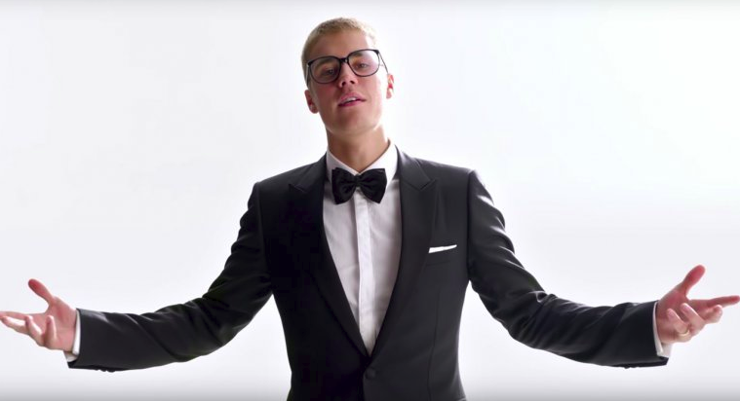
THE END

